Slide 1
SQL PROJECT
DONE BY
BAVITHA C

Slide 2
What is My Sql :
SQL stands for structured Query Language (sql) is,Fundamentally,a programming language designed for accessing, modifying and extracting information from relational databases.
Helps you to access and manipulate databases.
An official SQL standard was adopted by the American National standards Institute (ANSI) in 1986, with the International Organization for standardization (ISO) adopting the standard in 1987.

Slide 3
What is Database?
A database is an organized collection of structured information, or data, typically stored electronically in a computer system.
. A database is usually controlled by a database management system (DBMS).
The data can then be easily accessed, managed, modified, updated, controlled, and organized.
Most databases use structured query language (SQL) for writing and querying data.

Slide 4
What is RDBMS?
A Relational Database Management System(RDBMS) is a database management system(RDBMS) that is based on the relational model as introduced by E.F.Codd.
Most popular commercial and open sourse databases currently in use are based on the relational model.
A short definition of an RDBMS may be a DBMS in which data is stored in the form of tables and the relationship among the data is also stored in the form of tables.

Slide 5
DIFFERENCE BETWEEN DBMS AND RDBMS
Data Base Management System
Data is stored as a file
Its supports single users
It does not support client server architecture
No relationship between data.
Relational Database Management System
Data is stored in the form of tables
It supports multiple users
It support client-server architecture
Data is stored in the form of tables which are related to each other.

Slide 6
Features of MySQL
Relational Database Management System (RDBMS)
Easy to use
Storing Data is secure
Open Source & Free to download
Compatible on many Operating systems.

Slide 7
Commands
Data Query Language(DQL) Commands
Data Definition Language (DDL) commands
Data Manipulation Language (DML) commands

Slide 8
Different Types of Data Types
Numeric Types
Character String Types
Date and Time Types
Boolean Types
Binary Data Types
Enumerated Types
Geospatial Types
JSON Types
Custom and User Defined Types

Slide 9
Numeric Data Type
INT :Integer data type for storing whole numbers.
BIGINT :Large integer data type for very large whole numbers.
SMALLINT :Small integer data type for small whole numbers.
DECIMAL/NUMERIC :Fixed-point numeric data type that stores exact numeric values with a specified precision and scale.
FLOAT/REAL : Floating-point numeric data type for approximate numeric values with a specified precision.

Slide 10
Date And Time
DATE :Date data type for storing dates (Year,month,day).
TIME : Time date type for storing time of day.
DATETIME/TIMESTAMP :Date and time data type for storing both date and time information.
INTERVAL : Represents a period of time.

Slide 11
Data Query Language (DQL) Commands
SELECT- Retrieves data from one or more tables.
FROM- Specifies the table(s) from which to retrieve data.
WHERE-Filters data based on specified conditions.
GROUP BY-Groups data based on one or more columns.
HAVING-Filters grouped data based on conditions.
ORDER BY-Sorts the result set based on one or more columns.
JOIN-Combines rows from two or more tables based on a related column.

Slide 12
CREATING DATABASE,SHOW DATABASE,USE DATABASE & DROP DATABASE
Create database:- To create database
create database bavi;
Use bavi;
Show database:- show all created databases
show databases
Drop database:- to drop the database
Drop database bavi;

Slide 13
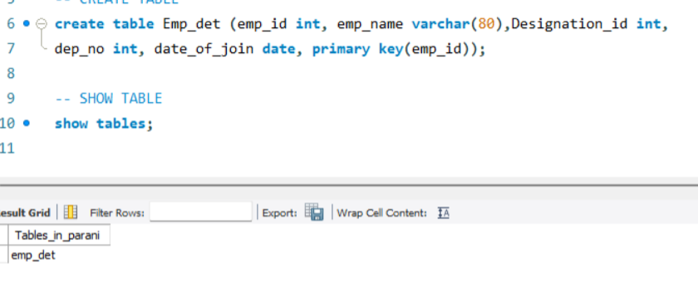
Create Table & Show Table

Slide 14
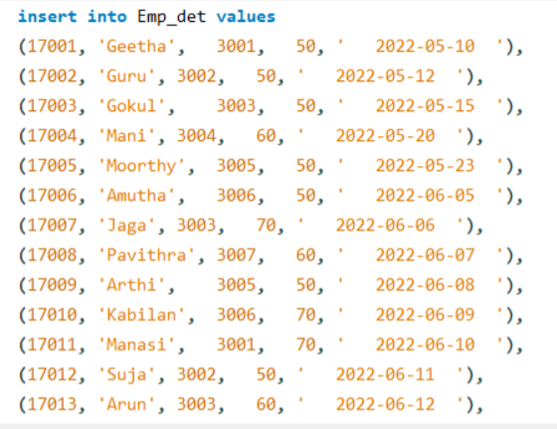
Insert Values insert values into table

Slide 15
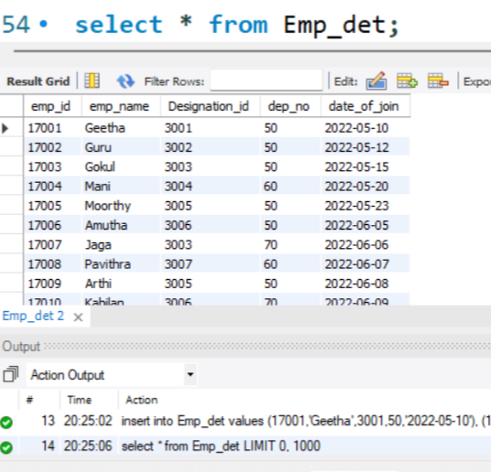
Select Query
The SELECT statement is used to select data from a database

Slide 16
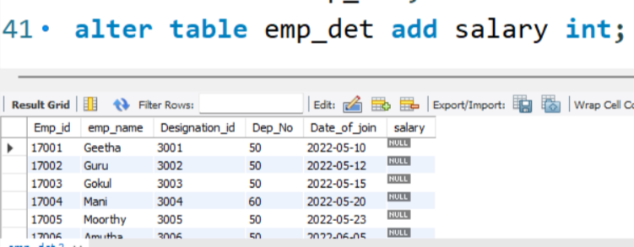
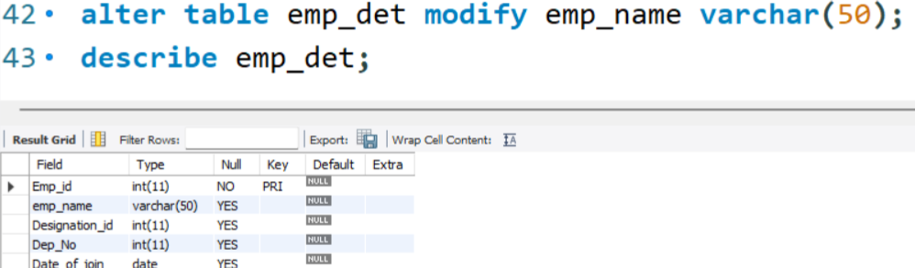
ALTER TABLE STATEMENT
The ALTER TABLE statement is used to add, delete, modify, drop & rename columns in an existing table.
ADD
Modify

Slide 17
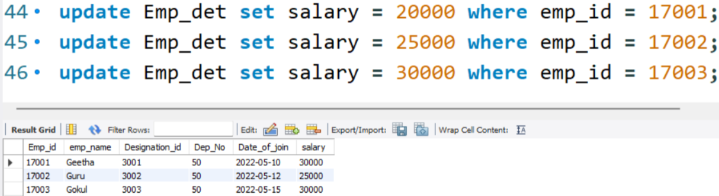
Update statement
The UPDATE statement is used to modify the existing records in a table

Slide 18
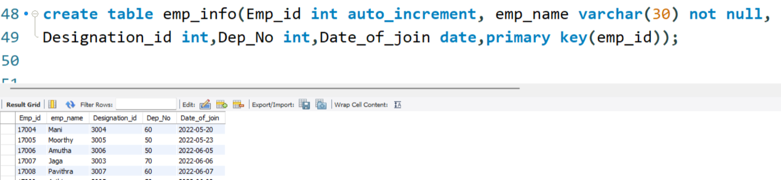
CONSTRAINTS
NOT NULL :-Ensures that A Column cannot have a null values
Auto increment:- it allows a unique number to be generated automatically when a new record is inserted into table
Default:-Sets a default value for column if no value is specified
Primary key:-Uniquely identifies each row in a table

Slide 19
SQL General Function
Where
Or
And
In
Not in
>=
<=
<>(Not in)
!
Count
Distinct
Count with Distinct
Order by ASC
Order by DESC
Group by
Limit
Desc limit
Like
Not like
Between

Slide 20
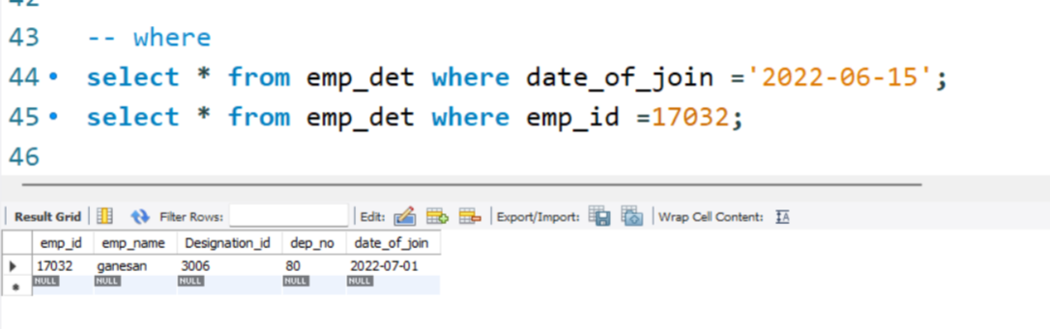
Where Query
The WHERE clause is used to filter record

Slide 21
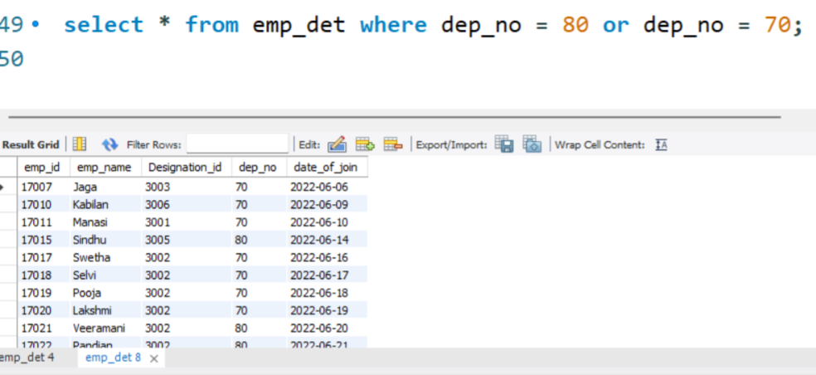
OR Query
The OR Operator displays a record if any of the condition separated by Or is true

Slide 22
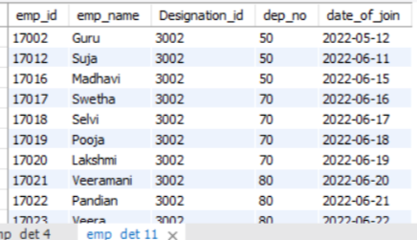
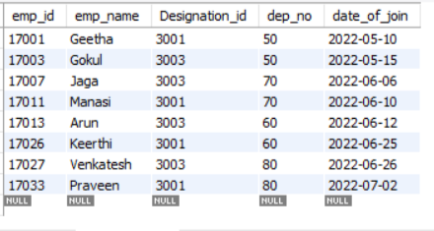
In Query & Not in
select * from emp_det where designation_id in(3001,3003);
select * from emp_det where designation_id not in(3001,3003,3004,3005,3006,3007);

Slide 23
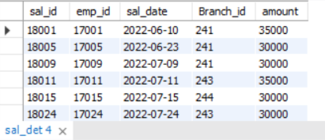
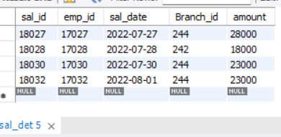
>= &<=
select * from sal_det where amount >=30000;
select * from sal_det where amount <30000;

Slide 24
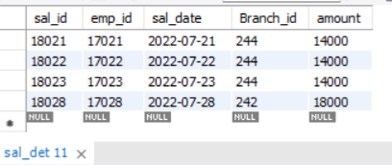
And Query
The AND Operator displays a record if all the condition separated by AND are true
select * from sal_det where amount >=10000 and amount <=20000;

Slide 25
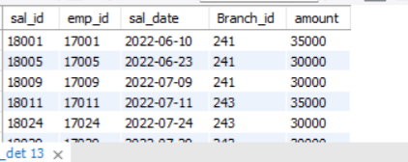
In & And
select * from sal_det where branch_id in ('241','243') and amount >=30000;

Slide 26
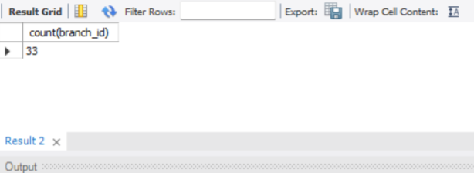
Or & And Query
select count(*) from sal_det;
select count(branch_id) from sal_det;

Slide 27
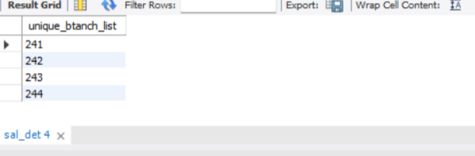
Distinct Query
The select distinct statement is used to return only different values
select count(distinct branch_id) unique_branch_id from sal_det;
select distinct branch_id unique_btanch_list from sal_det;

Slide 28
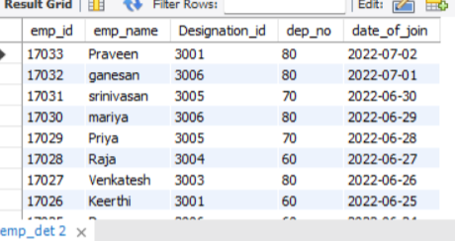
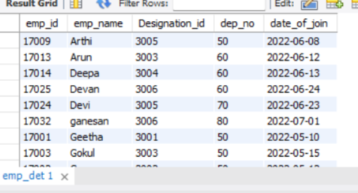
Order By Query
The ORDER BY keyword id used to sort the result-set in ascending or descending order
ASC Order
select * from emp_det order by emp_name asc;
DESC Order
select * from emp_det order by date_of_join desc;

Slide 29
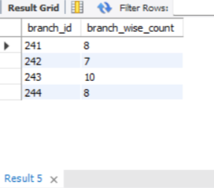
Group By
The GROUP BY statement groups rows that have the same values into summary rows, like "find the number of customers in each country".
select branch_id,count(emp_id)as branch_wise_count from sal_det group by branch_id;

Slide 30
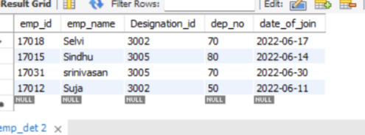
Limit Query
The LIMIT clause is used to specify the number of records to return.
select * from emp_det limit 10,5;
select * from emp_det order by emp_name asc limit 25,4;

Slide 31
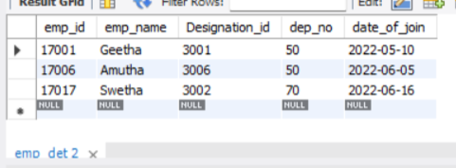
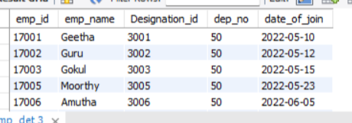
Like & Not Like Query
The LIKE operator is used in a WHERE clause to search for a specified pattern in a column.
Like
Not Like
select * from emp_det where emp_name like '%tha’;
select * from emp_det where emp_name not like '%i';

Slide 32
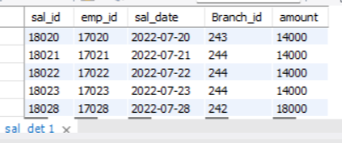
Between Query
The BETWEEN operator selects values within a given range. The values can be numbers, text, or dates.
select * from sal_det where amount between 10000 and 20000;

Slide 33
SQL Calculate Function
Sum
Average
Minimum
Maximum
Count
Round

Slide 34
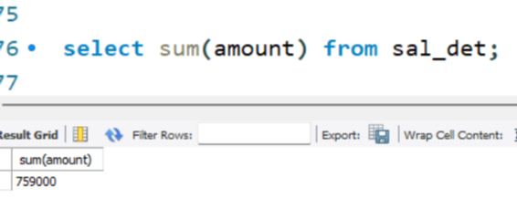
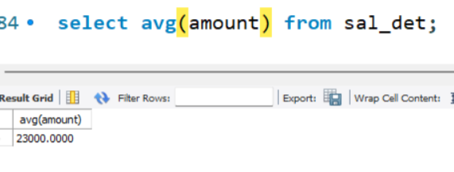
Calculate Function
Average
Sum

Slide 35
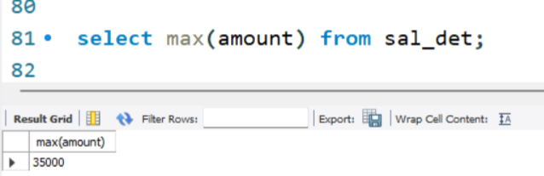
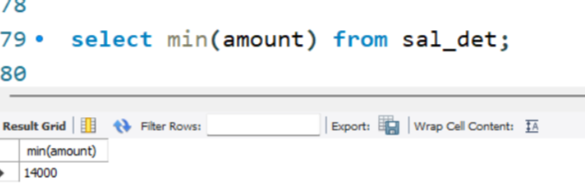
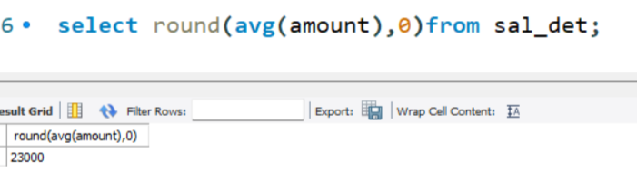
Maximum
Round
Minimum

Slide 36
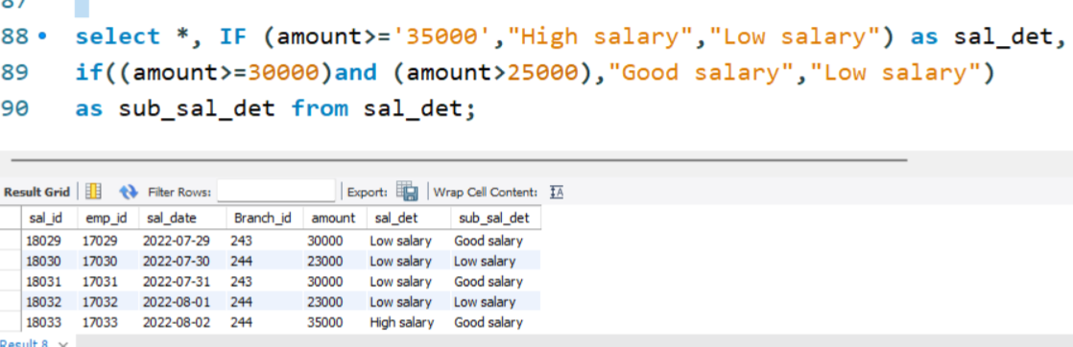
Logical Function
If with and condition
If with and Condition
If with or Condition

Slide 37
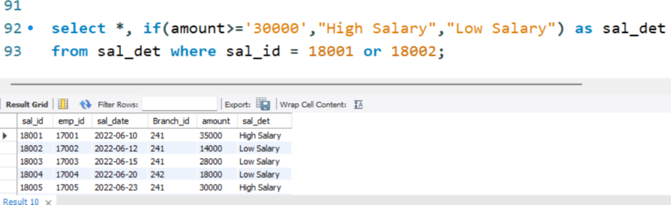
If with or Condition

Slide 38
String Function
Lcase(Lower Case)
Ucase(Uper Case)
Right
Left
Concat
Trim
Char_Length
Mid
Length

Slide 39
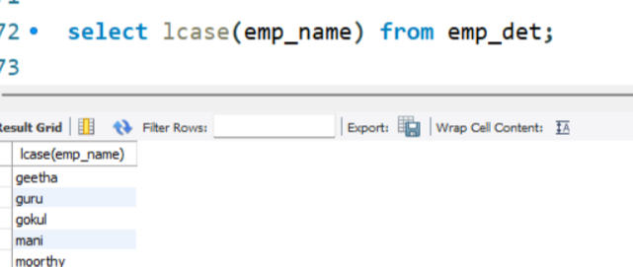
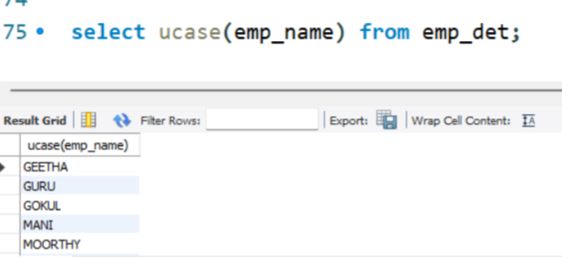
Lcase
Ucase
Left&Right

Slide 40
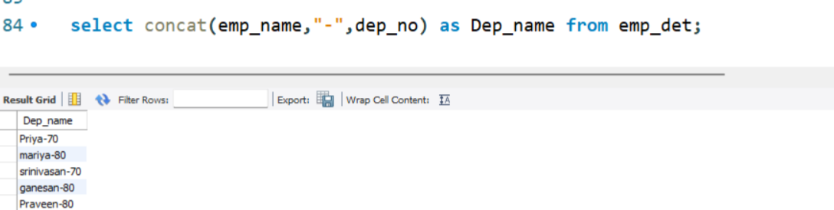
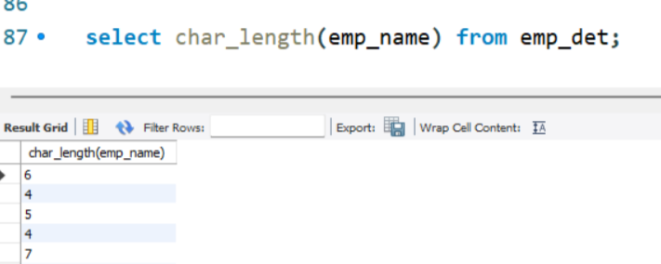
Concate
Char_Length

Slide 41
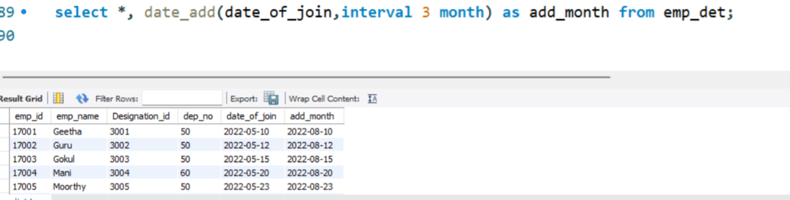
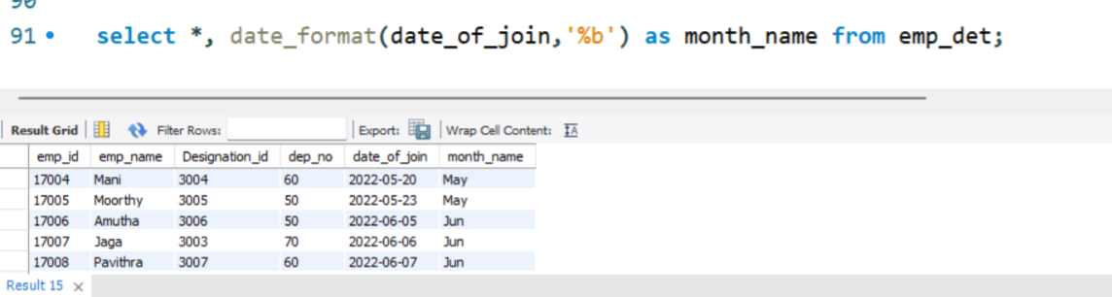
Date Functions
Date Add:- Add year or month or days to a date, then return the date
Date Format:- The Date Format() function formats a date as specified

Slide 42
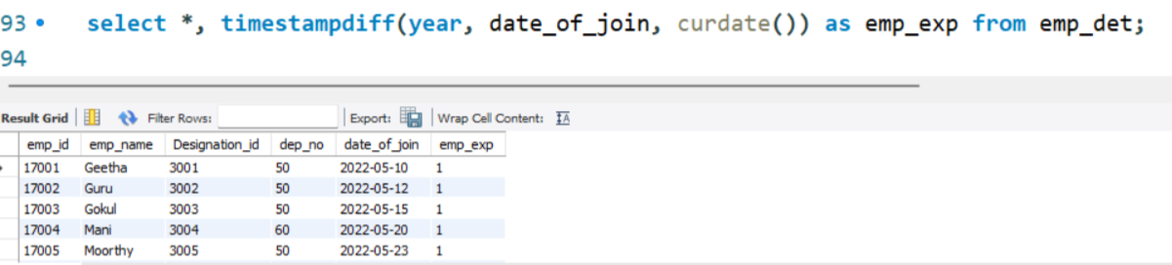
Timestamp Diff

Slide 43
Join Queries
Inner join
Cross join
Types of joins
Left join
Full outer join
Right join

Slide 44
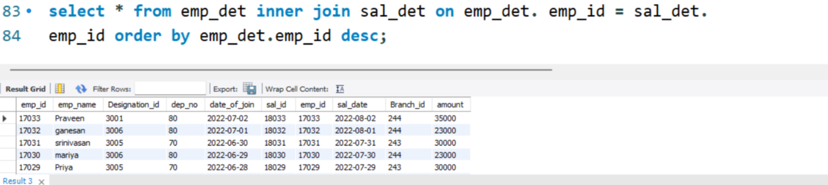
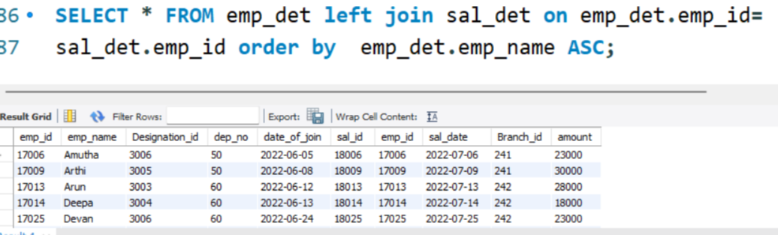
Inner join:-The Inner Join keyword selects records that have matching values in both tables
Left join:-

Slide 45
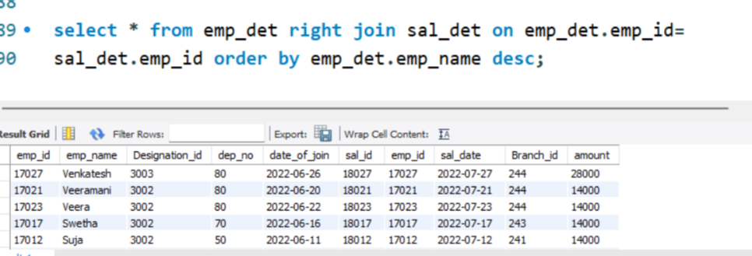
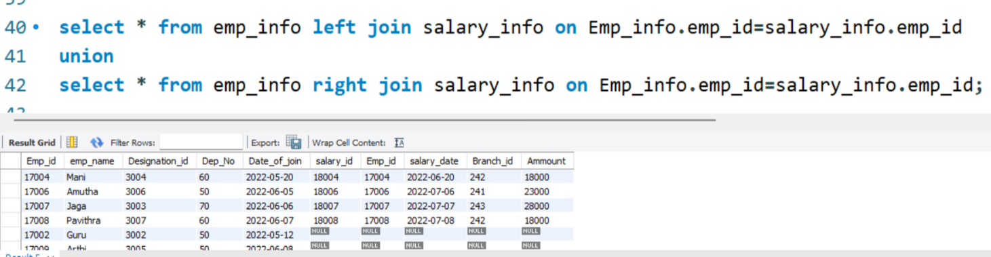
Right join:-
Union join:-The Inner Join keyword selects records that have matching values in both tables

Slide 46
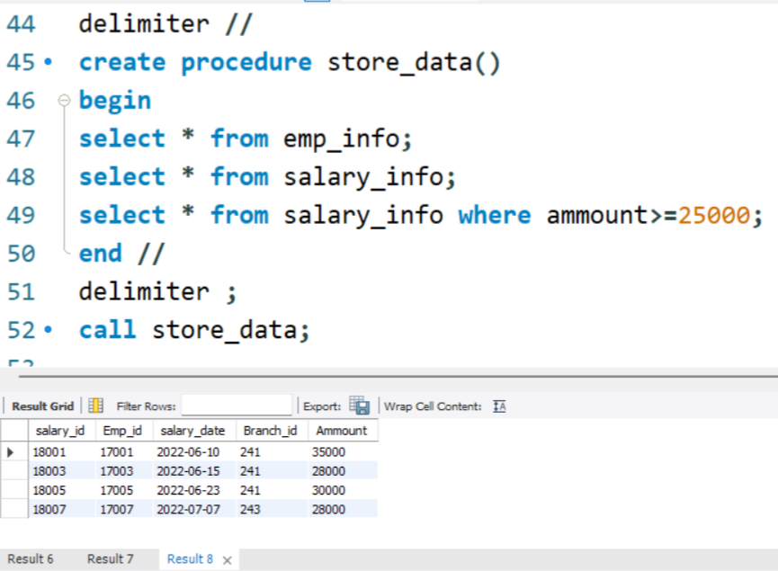
STORED PROCEDURES
A stored procedure is a prepared SQL code that you can save, so the code can be reused over and over again.

Slide 47
TRIGGER
Trigger:- A database trigger is stored program which is automatically fired or executed when some events occur
Types of trigger:- * Row level trigger
* Statement level trigger
Trigger timings:-
After insert
Before insert
Before update
After update
Before delete
After delete

Slide 48
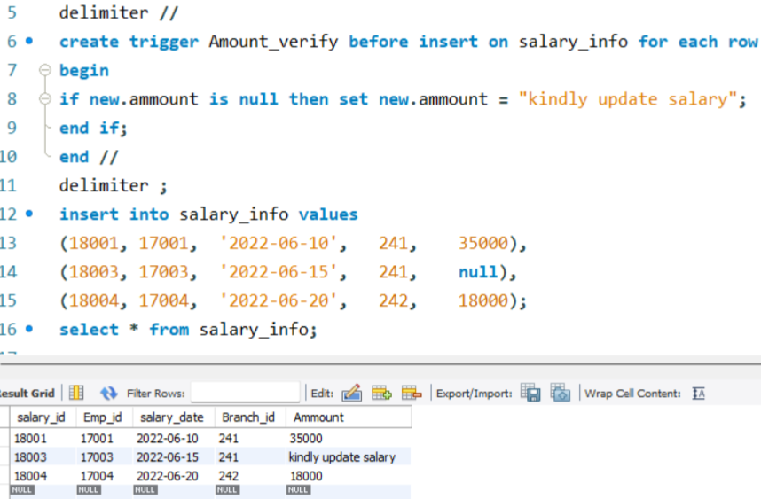
ROW LEVEL TRIGGER
An event is triggered at row level for each row updated, inserted or deleted

Slide 49
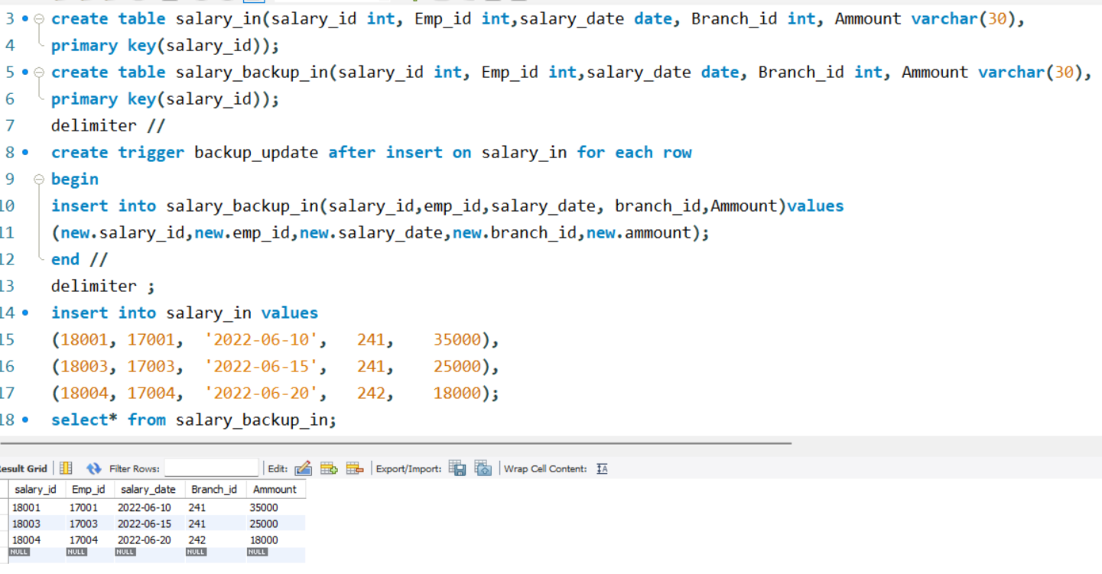
STATEMENT LEVEL TRIGGER
An event is triggered at table level for each SQL statement executed

Slide 50
THANK YOU

